Slide 1

“National Standards & Benchmarks for Effective Catholic Elementary and Secondary Schools” Momentum Feb/ Mar. 2012

Slide 2
Mission & Catholic Identity

Slide 3
Standard 1: An excellent Catholic School-

Slide 4
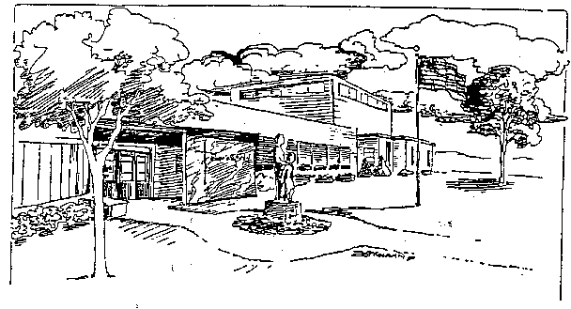
is guided & driven by a clearly communicated mission
Bishop Garrigan Schools are dedicated to providing quality, parish supported, value centered Catholic education to students and families of north central Iowa. We seek to achieve a balance between Christian social conscience and academic excellence through a combination of belief in God, service to our fellow human beings, intellectual preparation, and physical development.

Slide 5
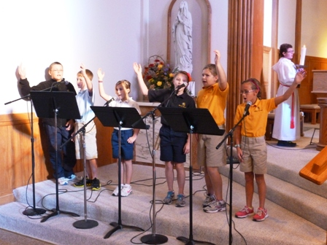
that embraces a Catholic Identity

Slide 6
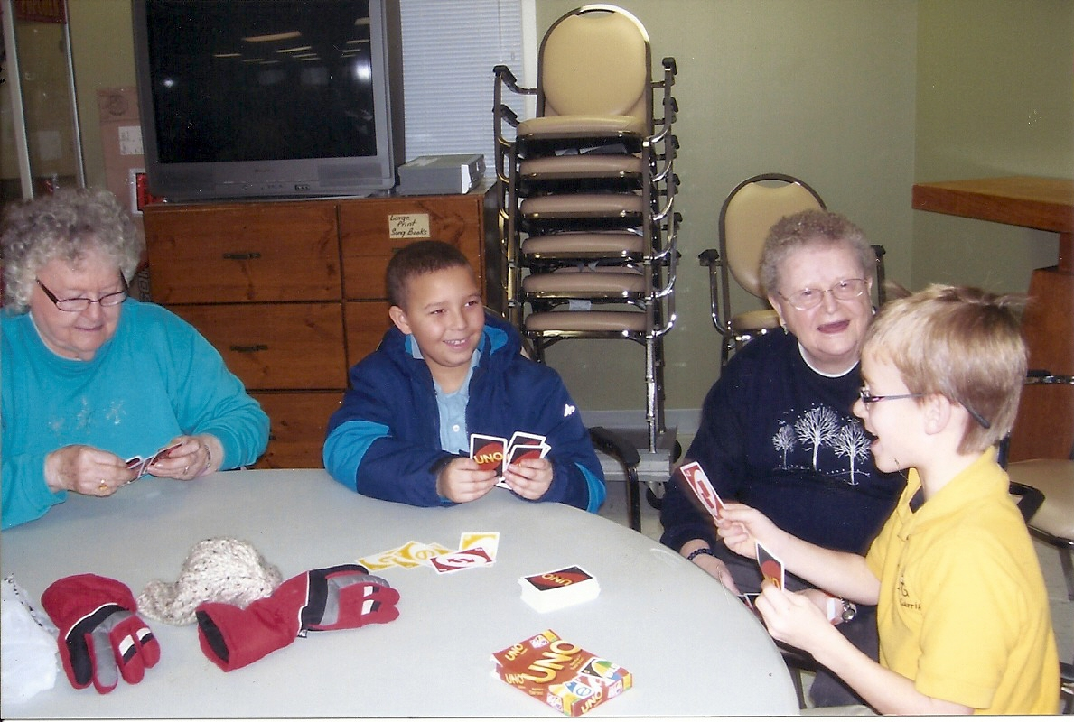
rooted in Gospel values

Slide 7
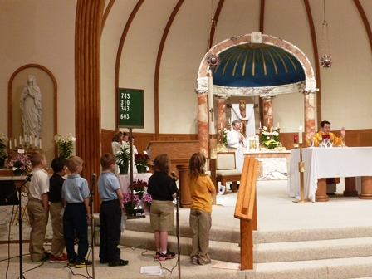
centered on the Eucharist

Slide 8
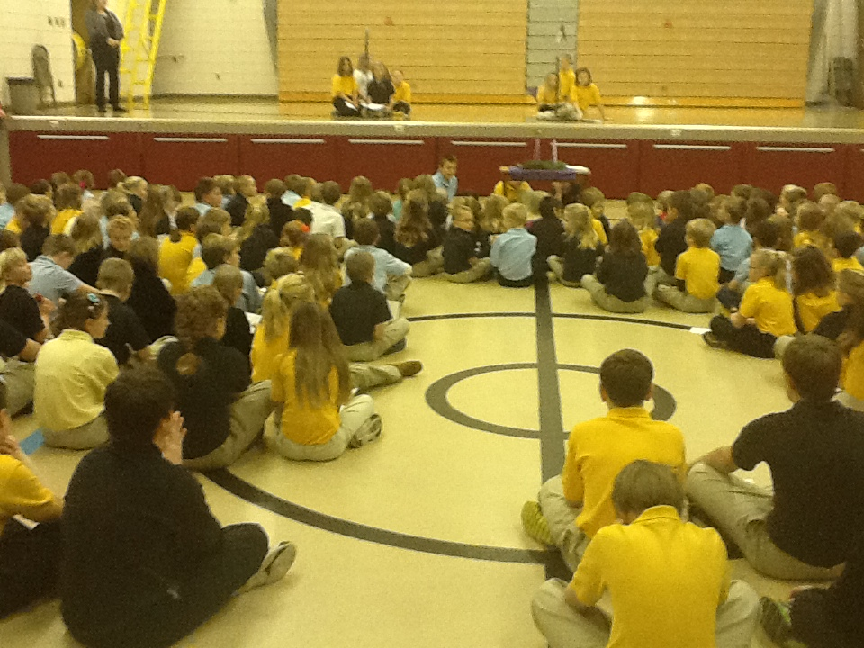
and committed to faith formation

Slide 9
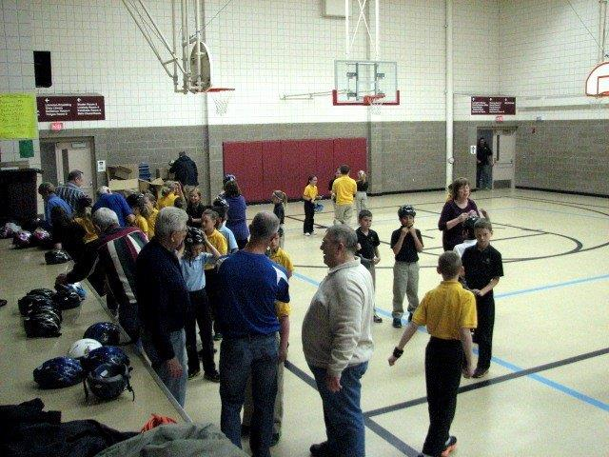
academic excellence and service.

Slide 10
Standard 2: An excellent Catholic school-

Slide 11
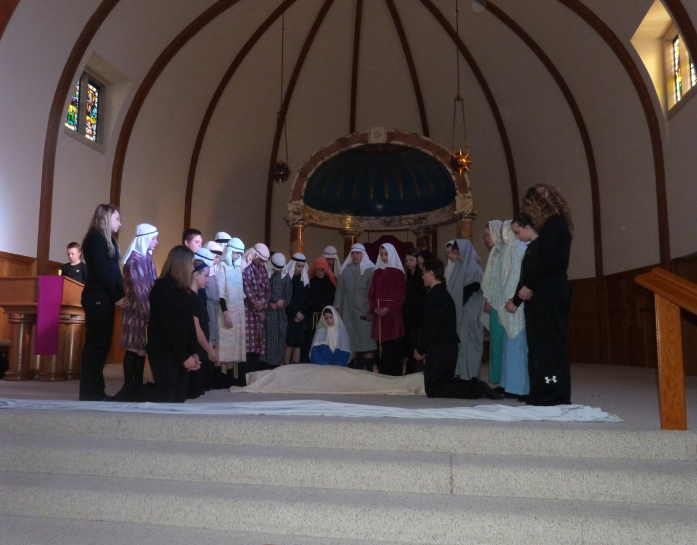
Provides a rigorous academic program for religious studies and catechesis in the Catholic Faith…

Slide 12
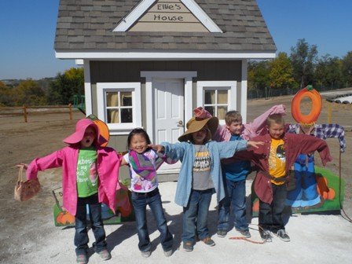
Set within a total academic curriculum that integrates faith, culture and life.

Slide 13
Standard 3: An excellent Catholic school-

Slide 14
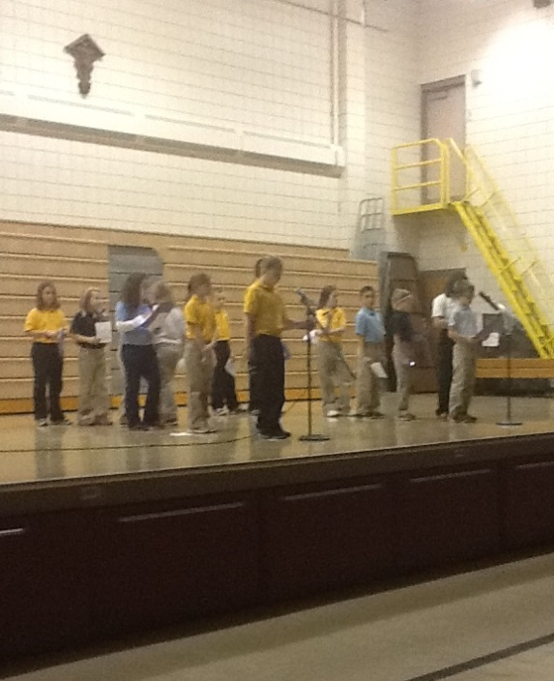
Provides opportunities outside the classroom for student faith formation,

Slide 15
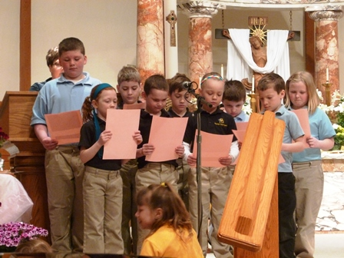
Participation in liturgical and communal prayer

Slide 16
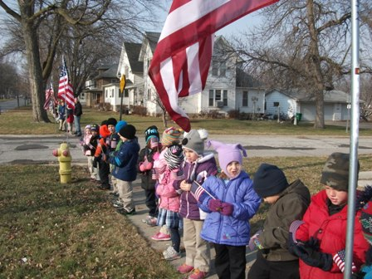
And action in service for social justice.

Slide 17
Standard 4: An excellent Catholic School-

Slide 18

Provides opportunities for adult formation and action in service of social justice.

Slide 19
Governance & Leadership

Slide 20
Standard 5: An excellent Catholic school-

Slide 21
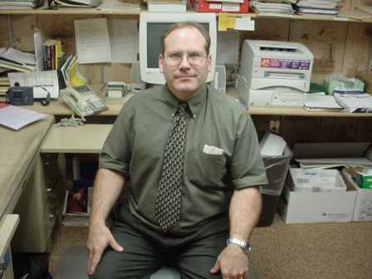
Has a governing body which exercises responsible decision making in collaboration with leadership team for development of the mission.
Bishop Garrigan School Board Appoints Lynn Miller as President.

Slide 22
Standard 6: An excellent Catholic school-

Slide 23
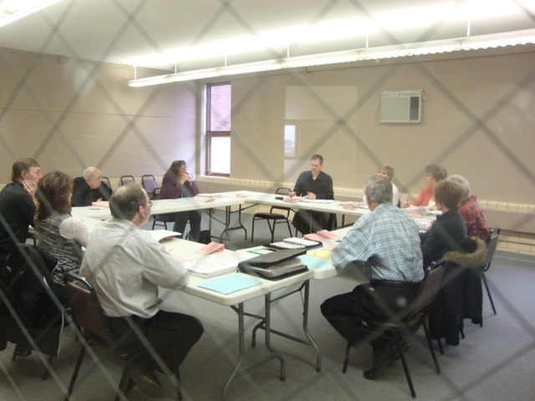
Has a qualified leadership team empowered by the governing body to realize & implement the school’s mission.

Slide 24
Academic Excellence

Slide 25
Standard 7: An excellent Catholic School-

Slide 26
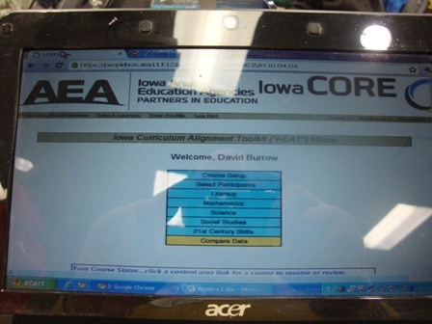
Has an articulate & rigorous curriculum aligned with standards,

Slide 27
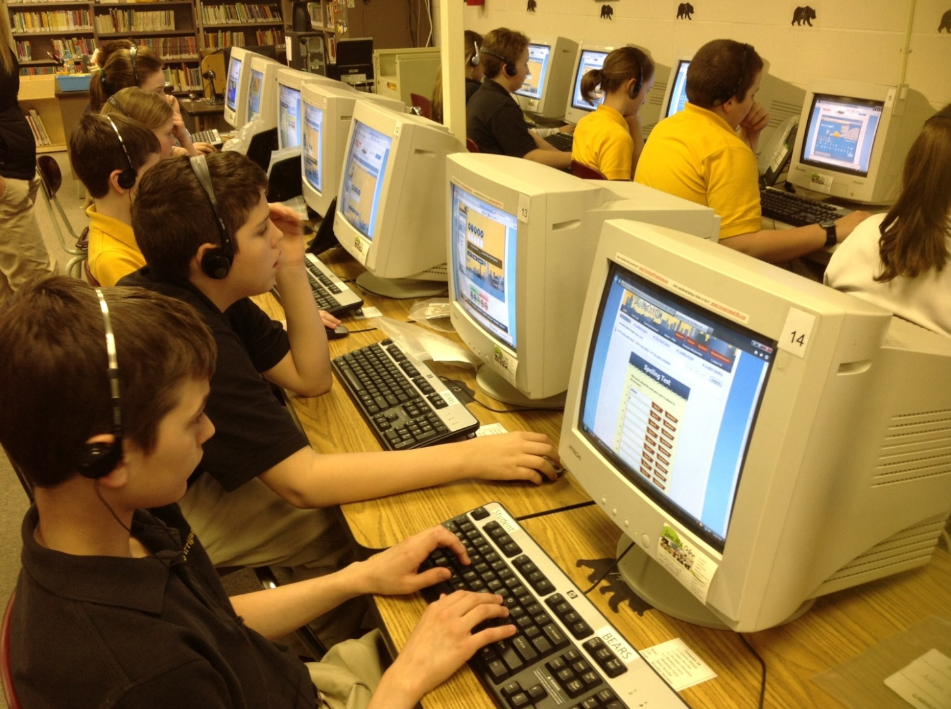
21st century skills

Slide 28
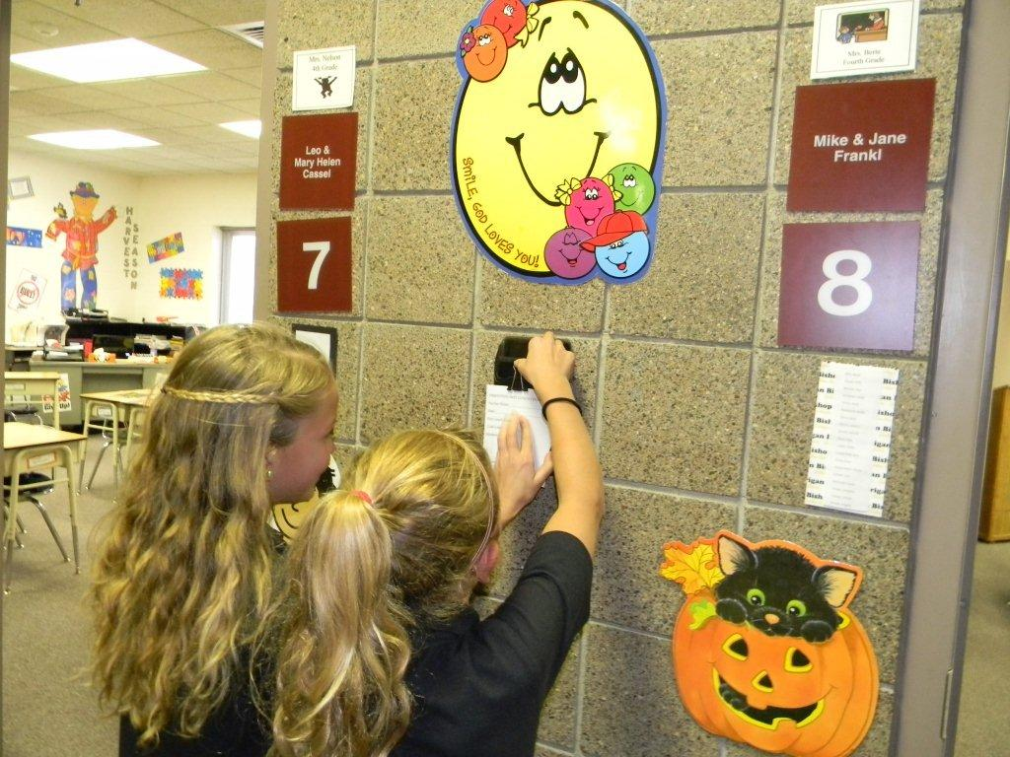
and gospel values.

Slide 29
Standard 8: An excellent Catholic School-

Slide 30
Uses school-wide assessment methods to document student learning & program effectiveness.
Bishop Garrigan Schools
Nationwide 60% of all students are considered either proficient or advanced in reading, mathematics, and science, while 40% have scores that are below the proficient level.
The Bishop Garrigan schools have a higher percentage proficient at all grade levels than the nationwide average.
Reading Proficiency
Reading (Oct.2012) | Non-Proficient (NP) | Proficient (P) | Advanced (A) | Total Proficient (P + A)
4th Grade | 33% | 47% | 20% | 67%
8th Grade | 27% | 73% | 0% | 73%
11th Grade | 23% | 62% | 15% | 77%

Slide 31
To make the student performances transparent
Mathematics Proficiency
Math (Oct. 2012) | Non-Proficient (NP) | Proficient (P) | Advanced (A) | Total Proficient (P + A)
4th Grade | 25% | 47% | 28% | 75%
8th Grade | 19% | 65% | 16% | 81%
11th Grade | 18% | 74% | 8% | 82%

Slide 32
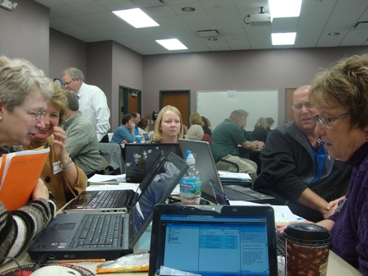
and to inform the continuous review of curriculum and improvement of instructional practices.

Slide 33
Operational Vitality

Slide 34
Standard 9: An excellent Catholic School-

Slide 35
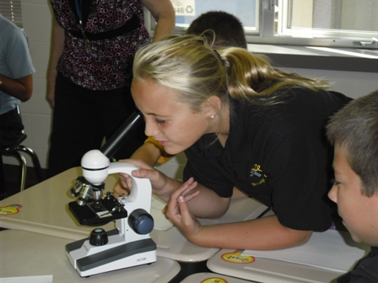
Provides programs and services aligned with the mission to enrich the academic program

Slide 36
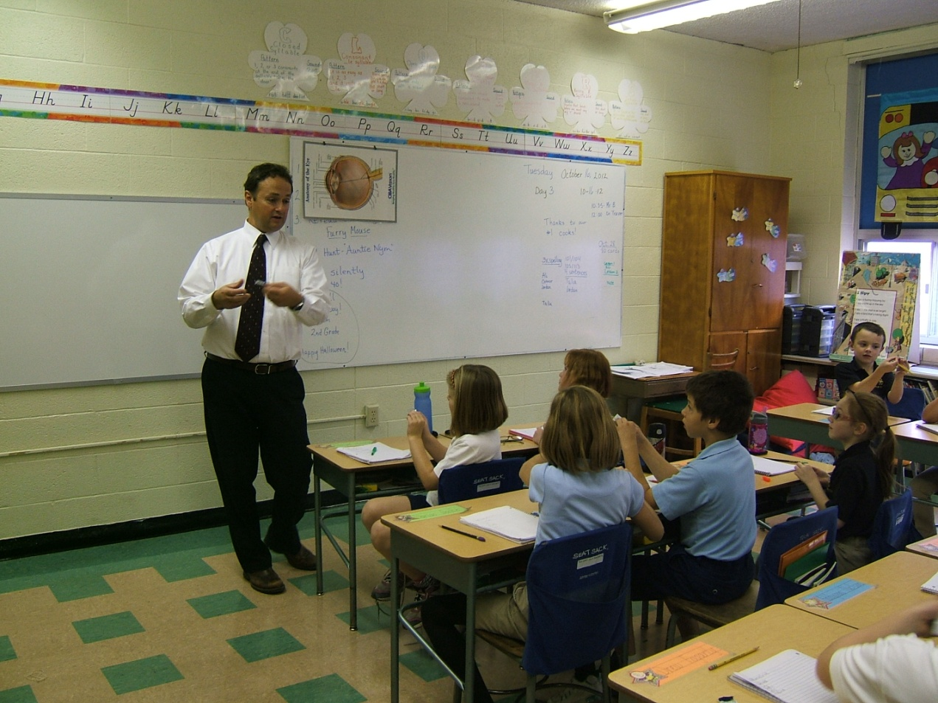
and support the development of student family & life.

Slide 37
Standard 10: An excellent Catholic School-

Slide 38
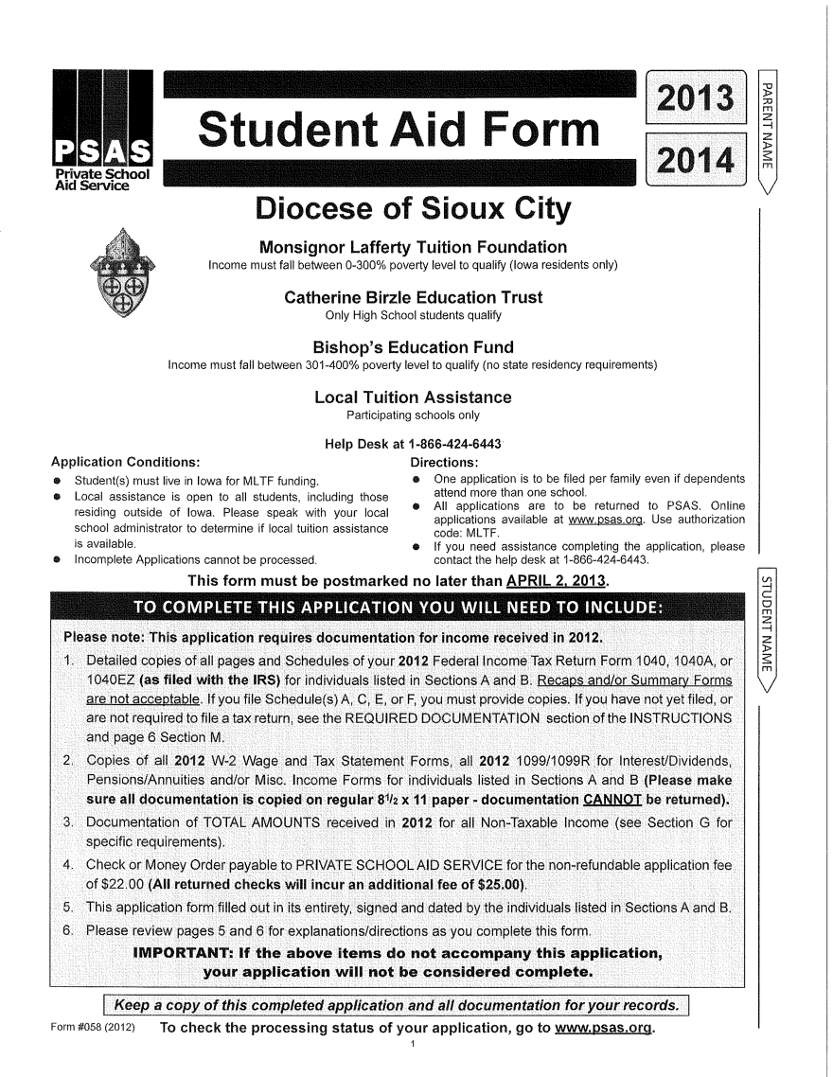
Provides a 3-5 year financial plan that includes both current and projected budgets emphasizing faithful stewardship.

Slide 39
Standard 11: An excellent Catholic School-

Slide 40
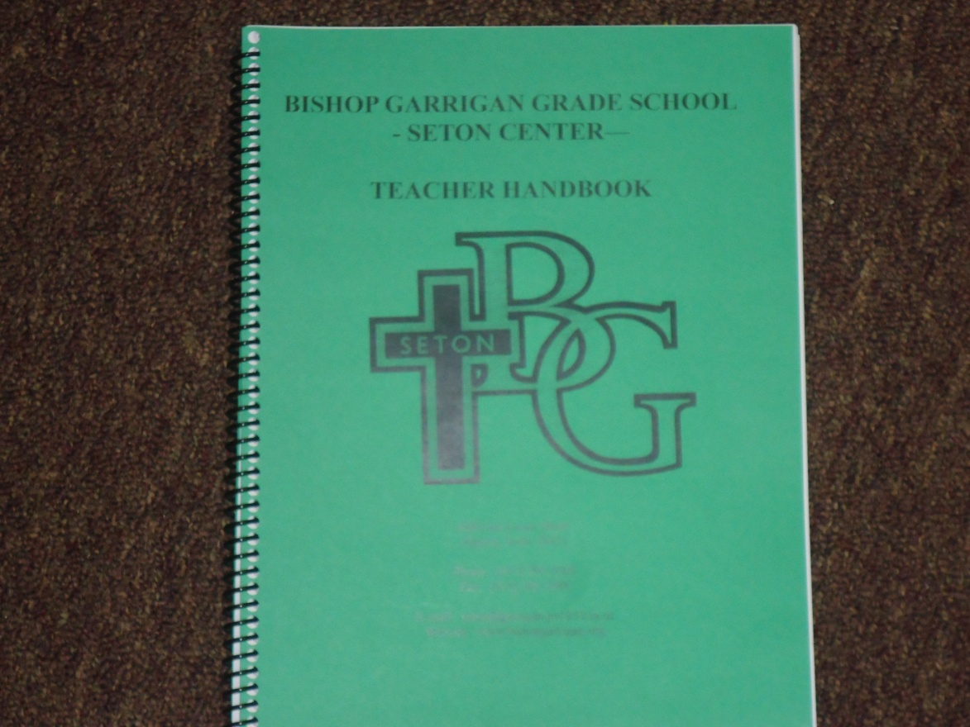
Operates in accord with published human resource/personnel policies which affect all staff. Responsibilities are well defined according to mission.

Slide 41
Standard 12: An excellent Catholic School-

Slide 42
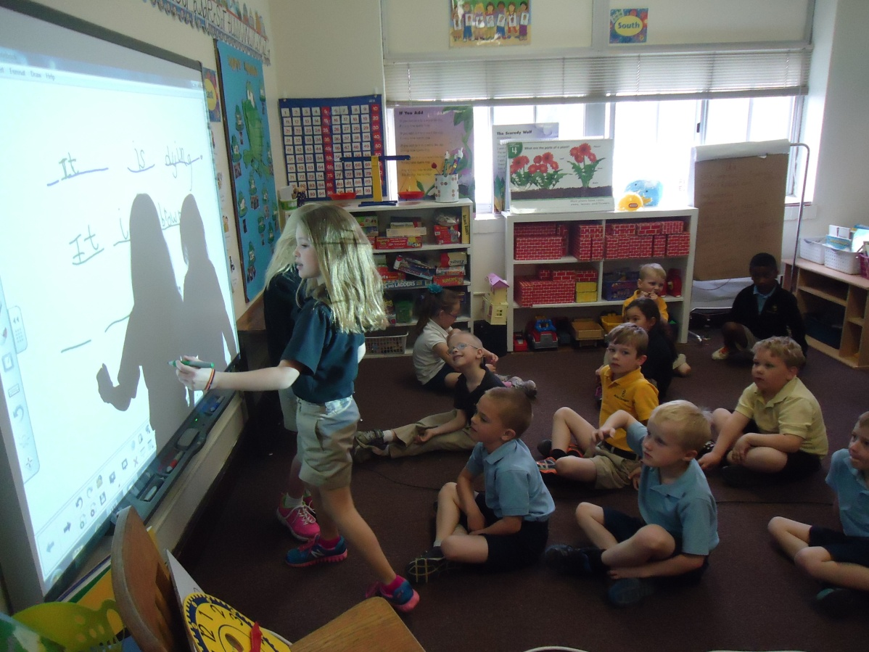
Develops and maintains facilities, equipment and technology management plan designed to support the mission.

Slide 43
Standard 13: An excellent Catholic School-

Slide 44
Enacts a comprehensive plan to develop the mission of the school through communications,
The Bishop Garrigan Schools have begun an exciting campaign called "Continuing the Tradition ... Expanding the Vision" which will help our school remain strong well into the future. There are three main goals of the campaign:
Building Project - a state-of-the-art gymnasium, together with additional classroom space and offices ($2,000,000)
Staff Endowment - to retain the finest instructors and continue our academic excellence ($1,000,000)
Tuition Assistance & Facilities Funds - to increase enrollment and maintain and modernize our facilities ($1,000,000)

Slide 45
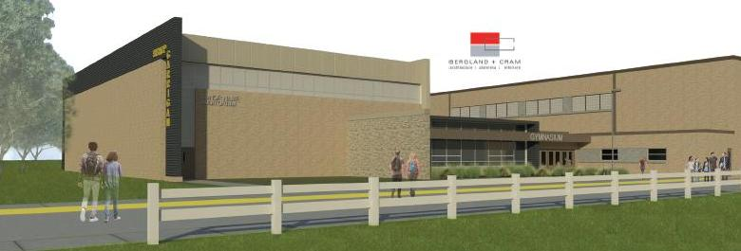
marketing,

Slide 46
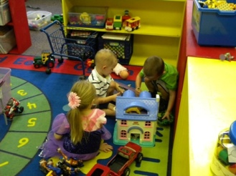
enrollment management

Slide 47
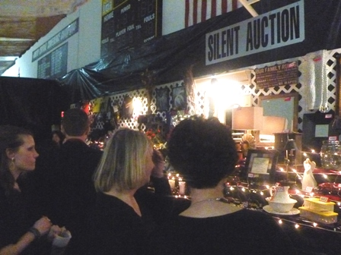
and development.

